Slide 1
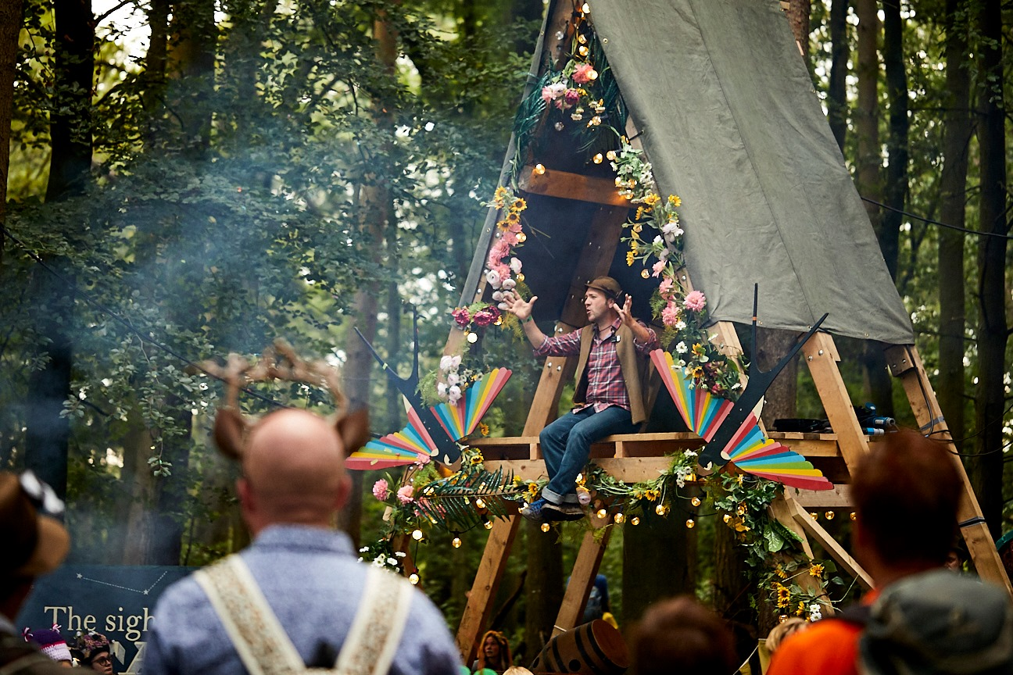
Remodelling your festival: – Temporary programmatic pivot or long term organisational change?
Rowan Cannon,
Wild Rumpus

Slide 2
WR Intro

Slide 3
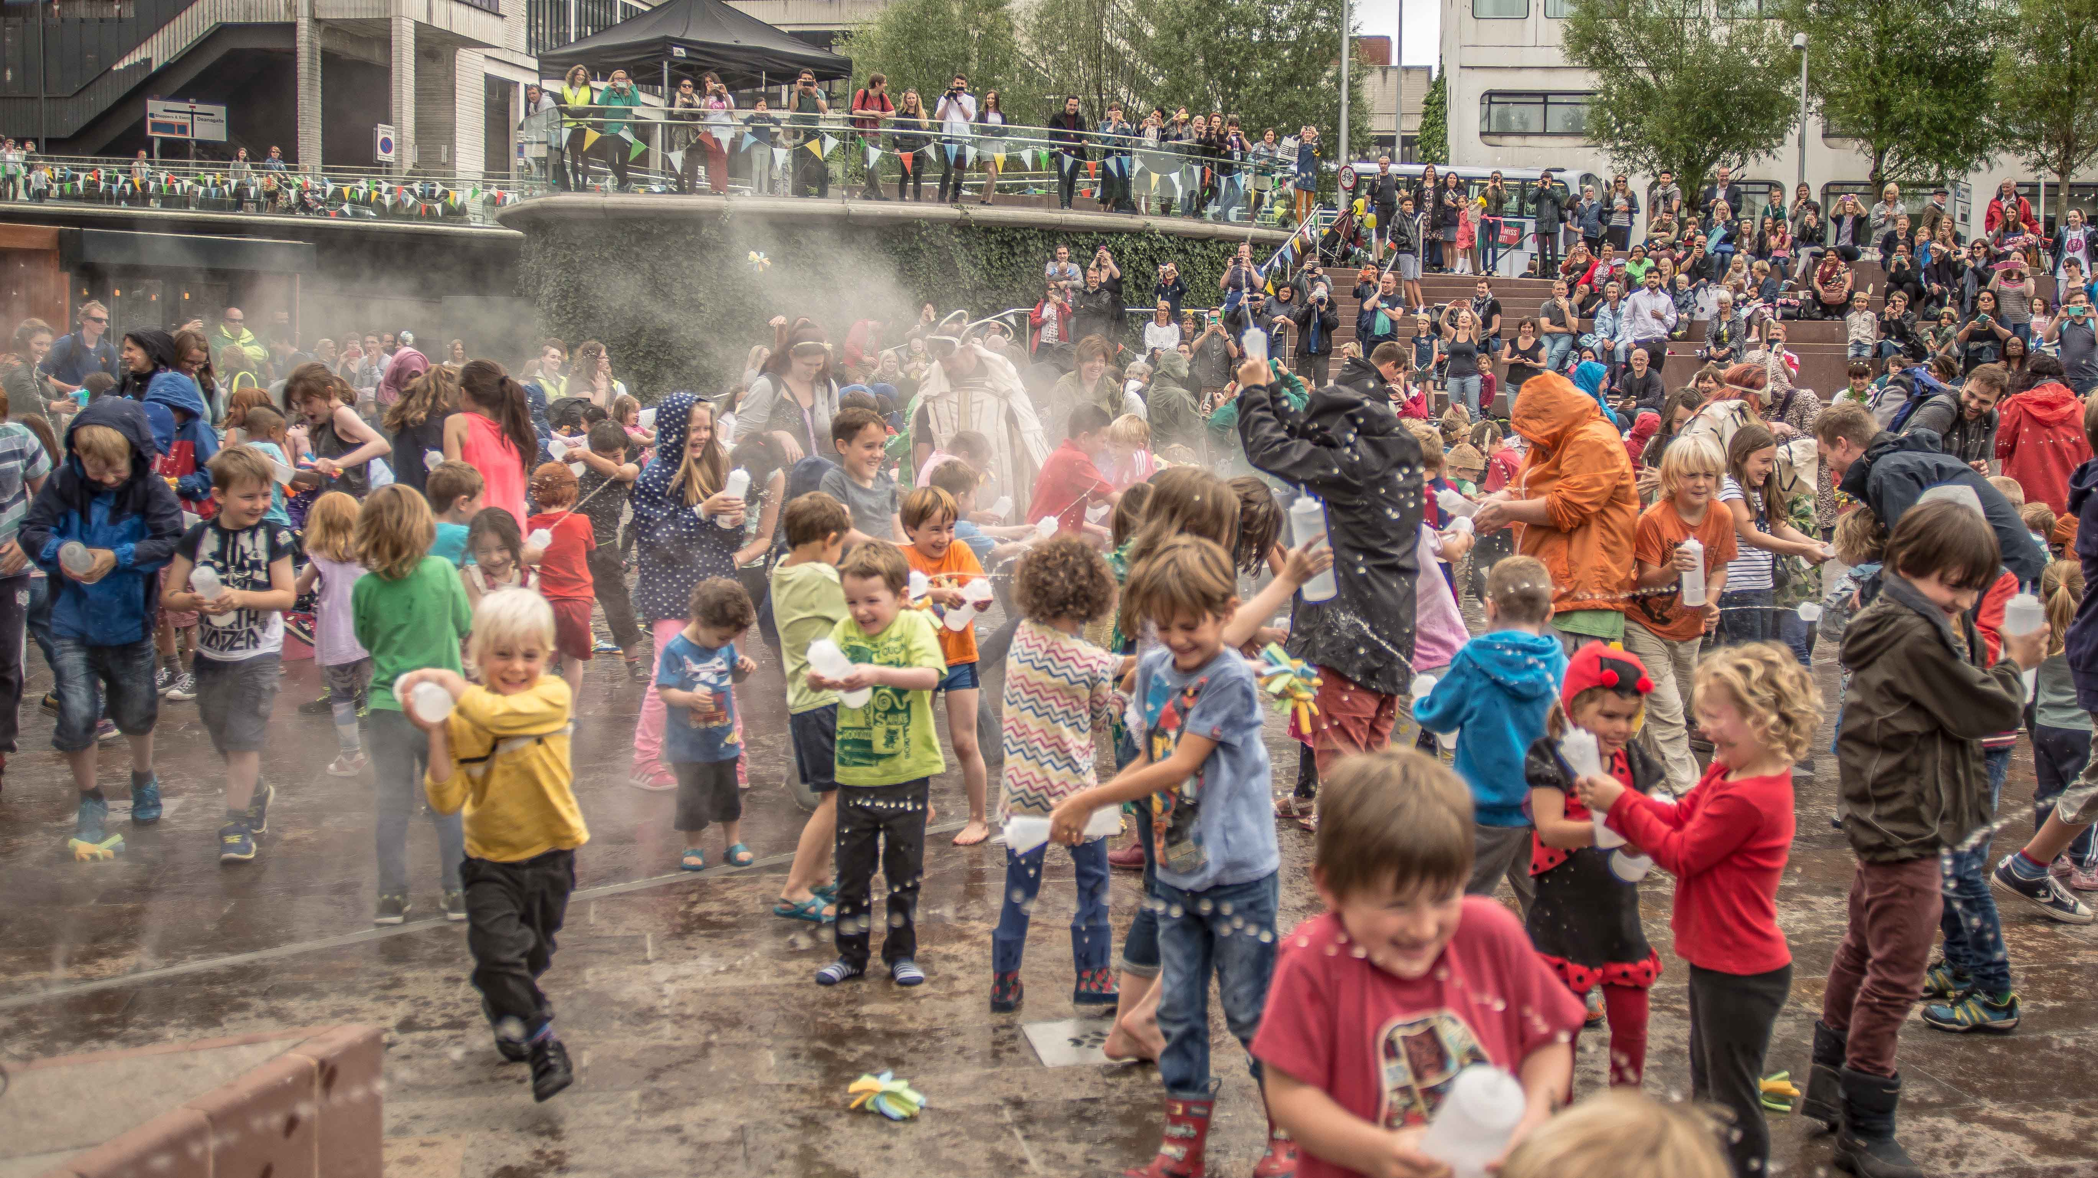
Business Model & Ways of Working
Facing Outwards
Festivals
Commissions
Public Engagement

Slide 4
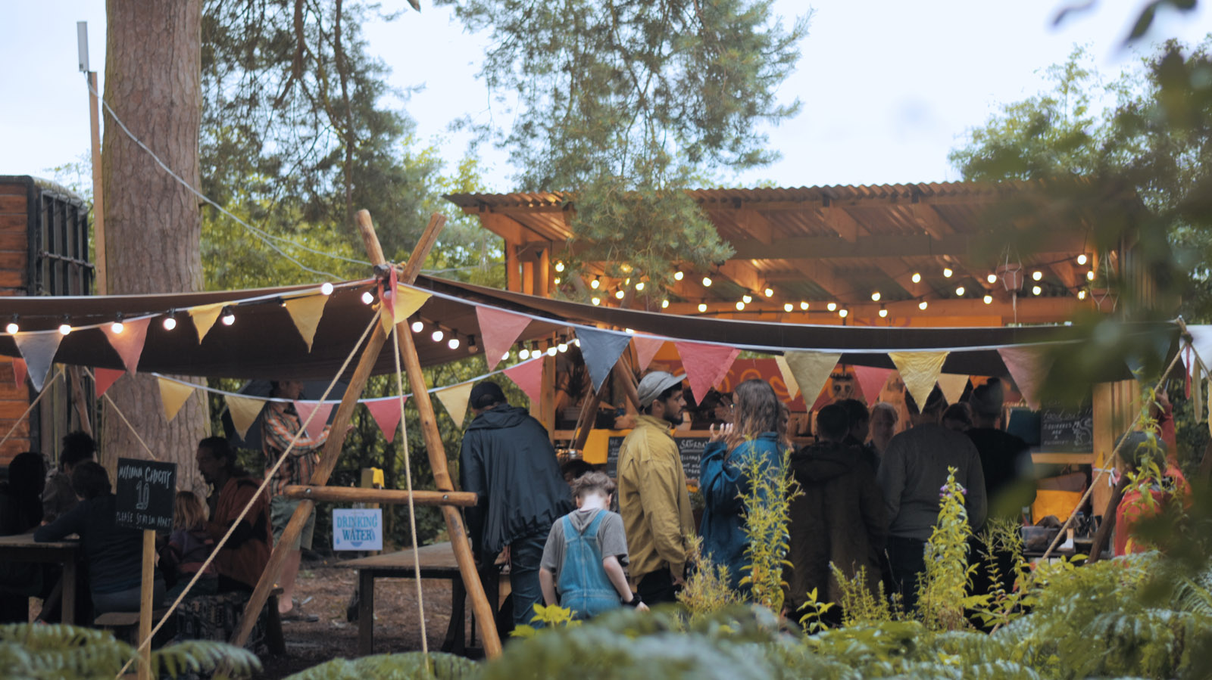
Facing Inwards
Artist Development
Sustainability Advocacy
Talent Development

Slide 5
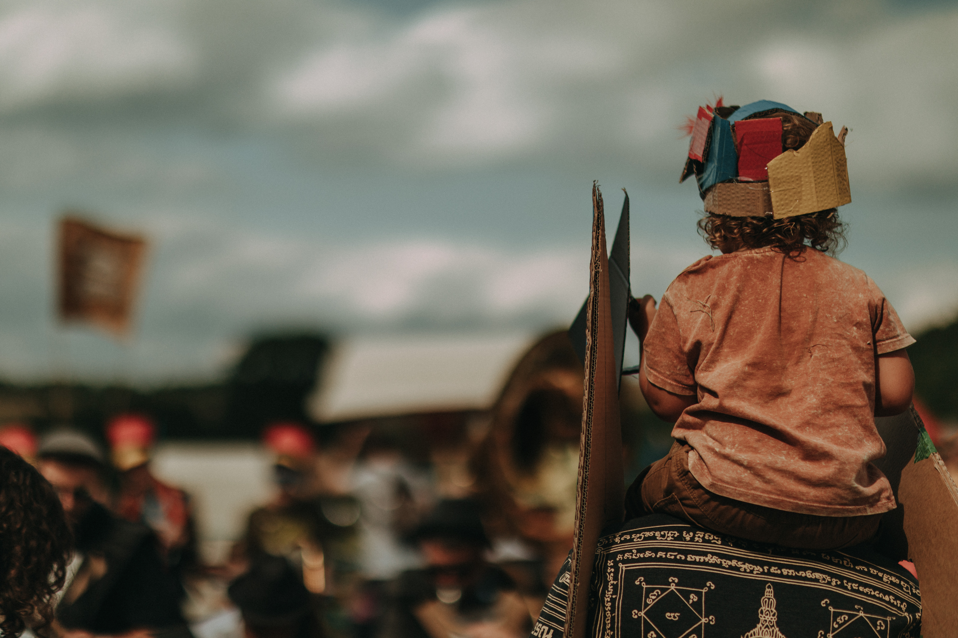
Covid - alternative activity rationale, we’re not interested in replacing the live experience.
Gathering in nature for collective experiences is a catalyst for change
Community
Exploration + Activism
Visceral Experiences

Slide 6
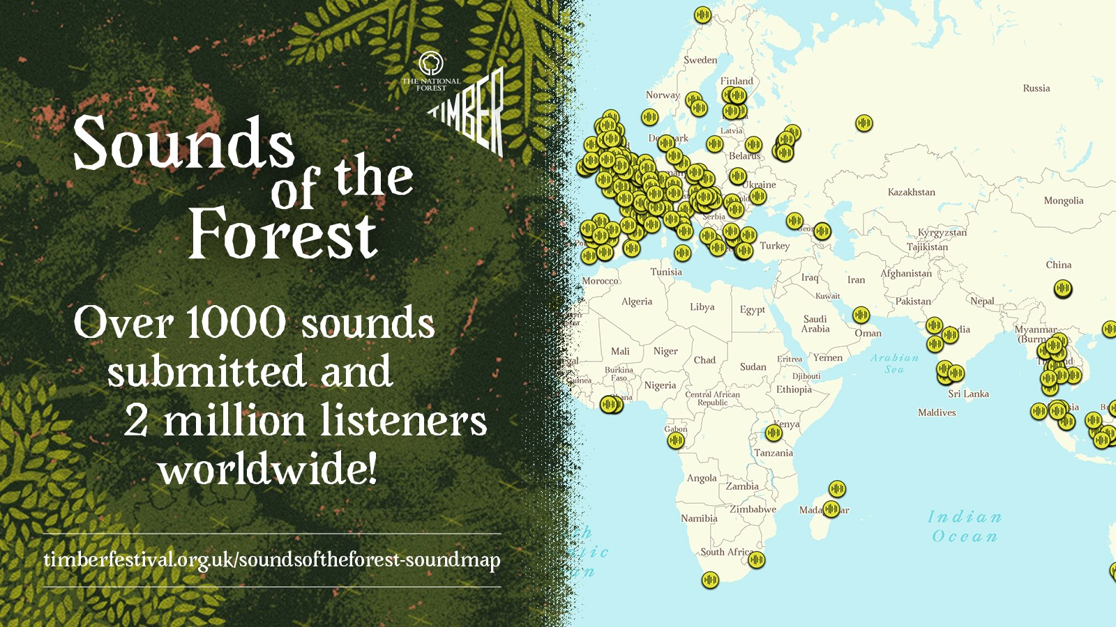

Slide 8
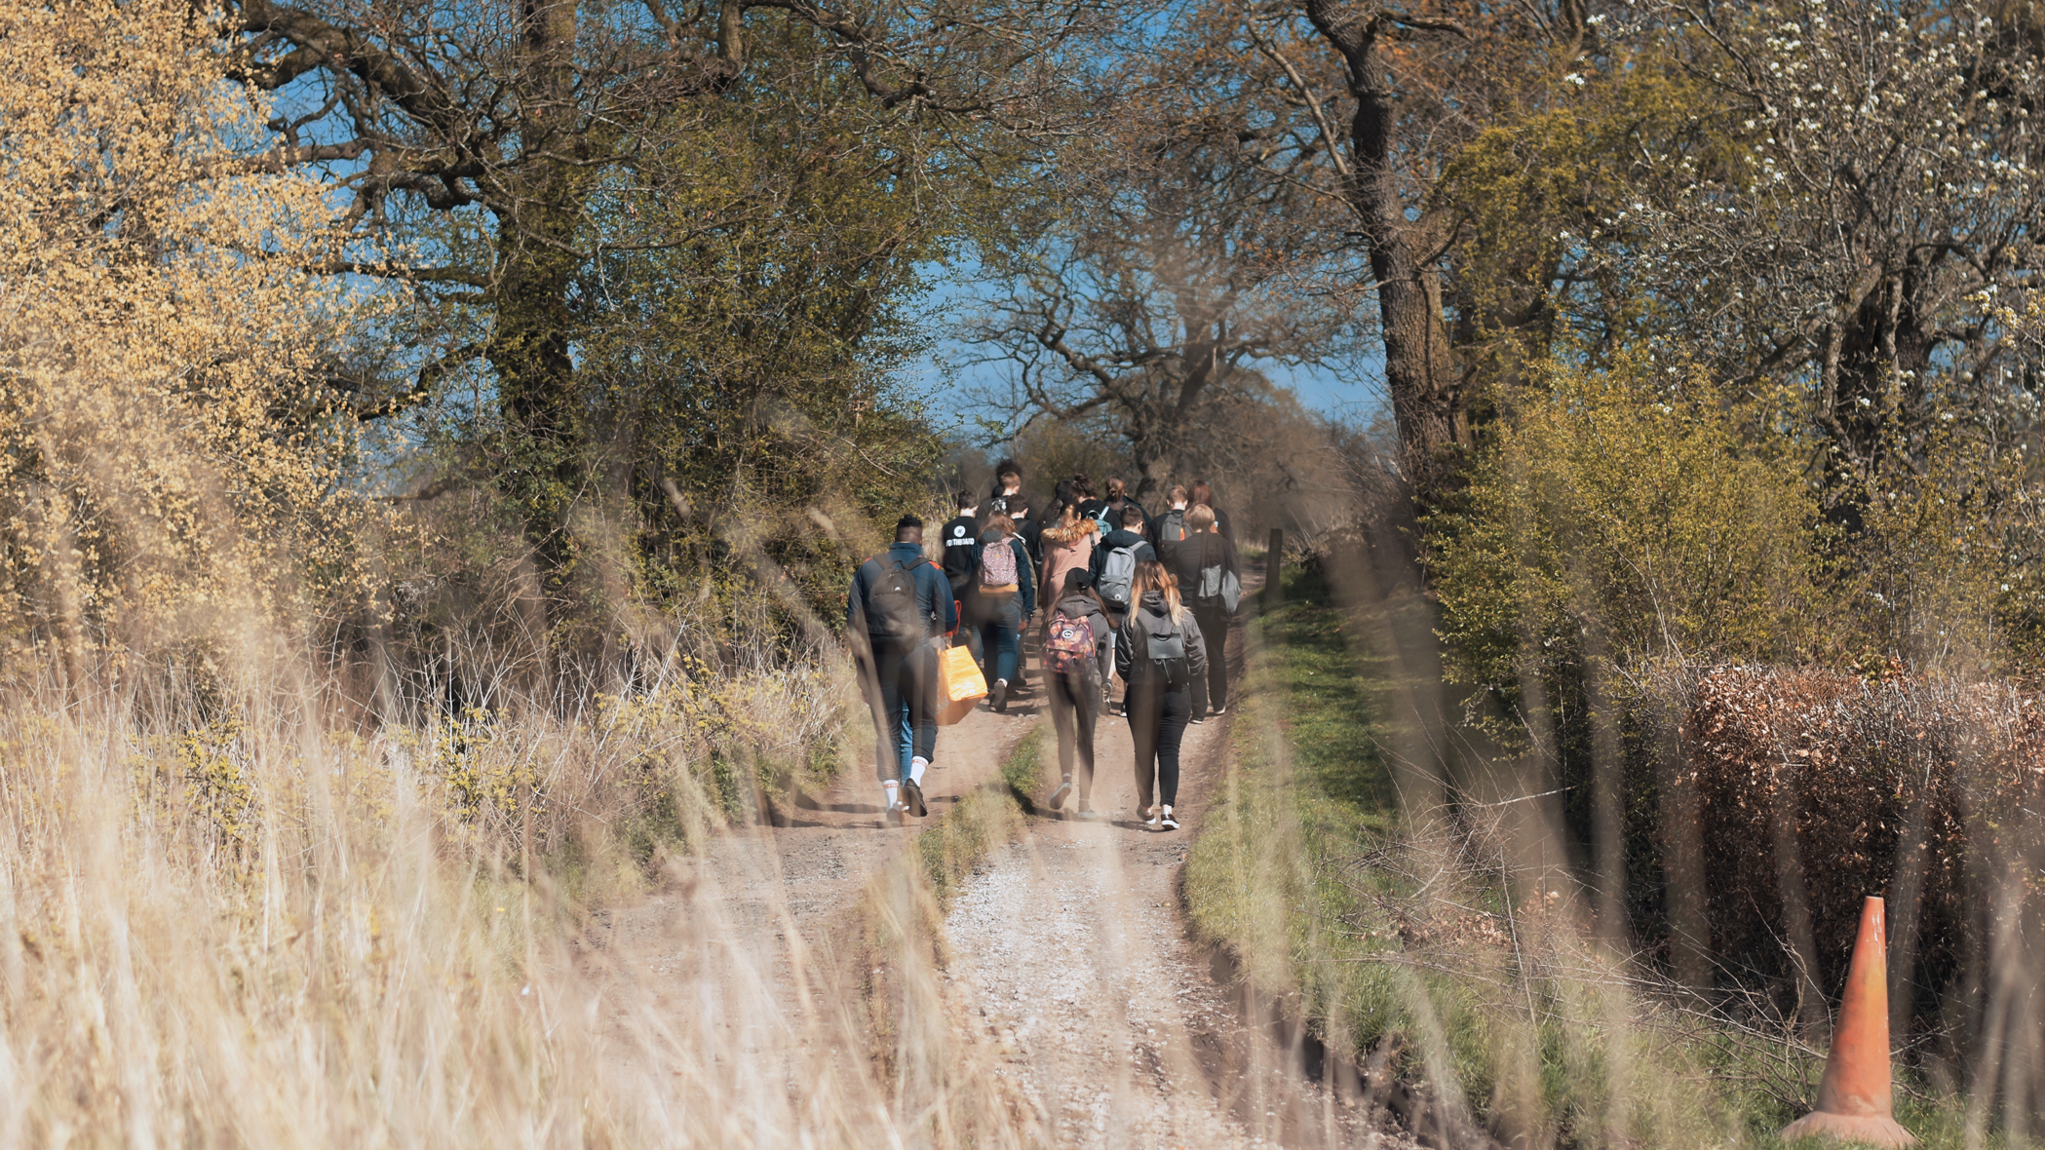
Learnings
Look beyond the familiar
Digital and analogue can sit hand in hand
Take your time, beconsidered and thoughtful
Be kind
Moments of collective wonder are possible in the digital realm…
… but more powerful in the flesh!

Slide 9
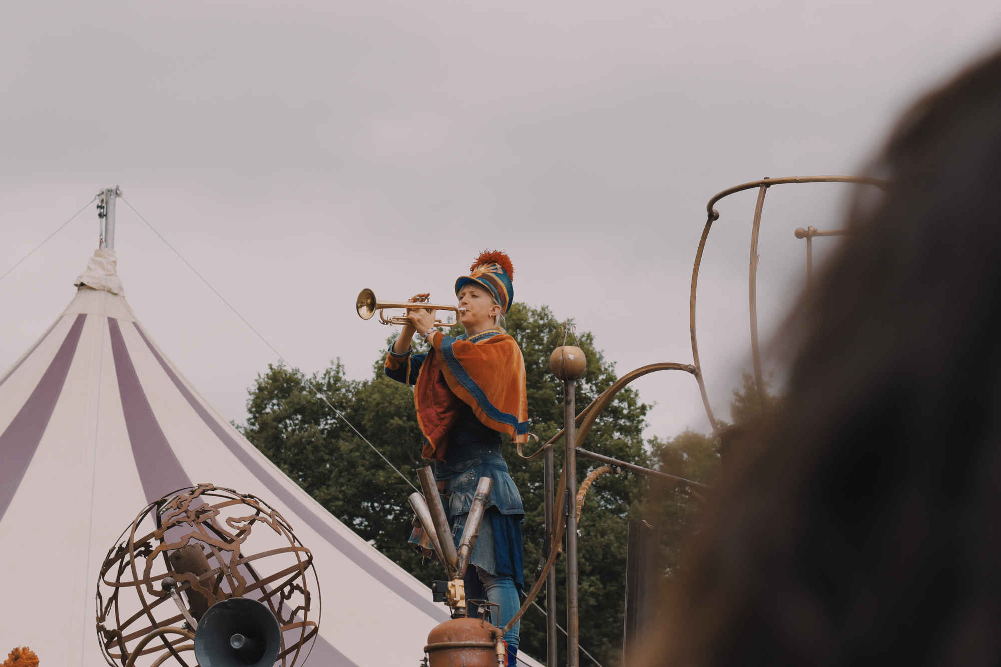
rowan.cannon@wildrumpus.org.uk
@rowan_cannon
@_wildrumpus
@justsofestival
@timber_festival

